Slide 3
1. GENERAL KNOWLEDGE - 10 QUESTIONS
2. NEWS AND CURRENT AFFAIRS - 10 QUESTIONS
3. MOVIE TRIVIA - 10 QUESTIONS
4. PICTURE ROUND - 9 QUESTIONS
5. WIPEOUT ROUND - 10 QUESTIONS
6. MUSIC ROUND - 10 QUESTIONS

Slide 4
GENERAL KNOWLEDGE ROUND

Slide 5
GENERAL KNOWLEDGE QUESTIONS
1. What is the standard tuning for a guitar?
2. What was the name of Oasis' last studio album?
3. Which masterchef judge is also a presenter on "Inside the Factory"?
4. Which national rugby union team is nicknamed "The Wallabies"
5. List the 5 spices of Spice Girls
6. What is the name of Warren Buffet's hedge fund?
7. The BCG vaccine is used in the prevention of which disease?
8. In public services, what does the initialism RNLI stand for?
9. Which 2019 film, is a sequel to both Unbreakable (2000), and Split (2016)
10. List 4 feature films released, starring Eddie Redmayne, from 2012 onwards

Slide 6
GENERAL KNOWLEDGE ANSWERS

Slide 7
GENERAL KNOWLEDGE ANSWERS
1. What is the standard tuning for a guitar?
1. EADGBE

Slide 8
GENERAL KNOWLEDGE ANSWERS
2. What was the name of Oasis' last studio album?
2. Dig out your soul

Slide 9
GENERAL KNOWLEDGE ANSWERS
3. Which masterchef judge is also a presenter on "Inside the Factory"?
3. Gregg Wallace

Slide 10
GENERAL KNOWLEDGE ANSWERS
4. Which national rugby union team is nicknamed "The Wallabies"
4. Australia

Slide 11
GENERAL KNOWLEDGE ANSWERS
5. List the 5 spices of Spice Girls
5. Scary, Sporty, Baby, Ginger, Posh

Slide 12
GENERAL KNOWLEDGE ANSWERS
6. What is the name of Warren Buffet's hedge fund?
6. Berkshire Hathaway

Slide 13
GENERAL KNOWLEDGE ANSWERS
7. The BCG vaccine is used in the prevention of which disease?
7. Tuberculosis

Slide 14
GENERAL KNOWLEDGE ANSWERS
8. In public services, what does the initialism RNLI stand for?
8. Royal National Lifeboat Institute

Slide 15
GENERAL KNOWLEDGE ANSWERS
9. Which 2019 film, is a sequel to both Unbreakable (2000), and Split (2016)
9. Glass

Slide 16
GENERAL KNOWLEDGE ANSWERS
10. List 4 feature films released, starring Eddie Redmayne, from 2012 onwards
10. The Trial of the Chicago 7
The Aeronauts
Fantastic Beasts: The Crimes of Grindelwald
Early Man
Fantastic Beasts and Where to Find Them
The Danish Girl
Thomas & Friends: Sodor's Legend of the Lost Treasure
Jupiter Ascending
The Theory of Everything
Les Misérables

Slide 17
NEWS AND CURRENT AFFAIRS ROUND

Slide 18
NEWS AND CURRENT AFFAIRS QUESTIONS
1. Which country recently ditched the monarchy, to be come a republic?
2. What object, named after James Webb, is due to be launched just before christmas?
3. Which international gift received recently was rather underwhelming?
4. How many £200 fines did TfL issue on Tuesday when new rules were introduced making masks mandatory? (within 40%)
5. Which of these was not a newly named welsh gritter: Gareth Hale, Catherine Sleeta-Jones, or Rhod Chill-bert
6. A man has recently received the world's first 3D printed what?
7. What In the news recently, what is Sotrovimab?
8. According to a recent YouGov survey, which 3 supermarkets have the highest approval rating? Choose from Aldi, Asda, Co-op, Iceland, Lidl, M&S Food, Morrisons, Sainsbury's, Tesco
9. Who was due to switch on the Christmas Lights in the East Village, but has had to cancel due to overwhelming demand?
10. Keir Starmer recently reshuffled his Shadow Cabinet. List 3 members of the labour shadow cabinet

Slide 19
NEWS AND CURRENT AFFAIRS ANSWERS

Slide 20
NEWS AND CURRENT AFFAIRS ANSWERS
1. Which country recently ditched the monarchy, to be come a republic?
1. Barbados

Slide 21
NEWS AND CURRENT AFFAIRS ANSWERS
2. What object, named after James Webb, is due to be launched just before christmas?
2. Telescope

Slide 22
NEWS AND CURRENT AFFAIRS ANSWERS
3. Which international gift received recently was rather underwhelming?
3. Trafalgar Square Tree

Slide 23
NEWS AND CURRENT AFFAIRS ANSWERS
4. How many £200 fines did TfL issue on Tuesday when new rules were introduced making masks mandatory? (within 40%)
4. 152 (91-213)

Slide 24
NEWS AND CURRENT AFFAIRS ANSWERS
5. Which of these was not a newly named welsh gritter: Gareth Hale, Catherine Sleeta-Jones, or Rhod Chill-bert
5. Rhod Chill-bert

Slide 25
NEWS AND CURRENT AFFAIRS ANSWERS
6. A man has recently received the world's first 3D printed what?
6. Prosthetic Eye

Slide 26
NEWS AND CURRENT AFFAIRS ANSWERS
7. What In the news recently, what is Sotrovimab?
7. Covid antibody treatment

Slide 27
NEWS AND CURRENT AFFAIRS ANSWERS
8. According to a recent YouGov survey, which 3 supermarkets have the highest approval rating? Choose from Aldi, Asda, Co-op, Iceland, Lidl, M&S Food, Morrisons, Sainsbury's, Tesco
8. Aldi, M&S Food, Lidl

Slide 28
NEWS AND CURRENT AFFAIRS ANSWERS
9. Who was due to switch on the Christmas Lights in the East Village, but has had to cancel due to overwhelming demand?
9. Alexandra Burke

Slide 29
NEWS AND CURRENT AFFAIRS ANSWERS
10. Keir Starmer recently reshuffled his Shadow Cabinet. List 3 members of the labour shadow cabinet
10. Angela Raynor
Anneliese Dodds
Shabana Mahmood
Rachel Reeves
Pat McFadden
David Lammy
Yvette Cooper
Bridget Phillipson
Lisa Nandy
Nick Thomas-Symonds
John Healey
Jonathan Ashworth
Rosena Allin-Khan
Jonathan Rynolds
Ed Miliband
Steve Reed
Wes Streeting
Lucy Powell
Jim McMahon
Louise Haigh
Preet Kaur Gill
Jo Stevens
Ian Murray
Peter Kyle
Kenny Chapman
Conor McGinn
Thangam Debbonaire
Baroness Smith
Alan Campbell
Lord Kennedy
Emily Thornberry

Slide 30
MOVIE TRIVIA ROUND

Slide 31
MOVIE TRIVIA QUESTIONS
1. In Back to the Future III, which year does Marty travel to?
2. Which Tom Cruise film features a glass egg?
3. Which of these films did not win an Academy Award for best picture: Birdman, Green Book, or Gravity?
4. The 2019 comedy Jojo Rabbit features a 10 year old boy - who is his imaginary friend?
5. Which film is set in a dystopian future Los Angeles of 2019?
6. In Pretty Woman, Richard Gere borrows his laywer's sports car - but what make is it: Lotus, Lamborghini or Ferrari?
7. In the 2008 pixar animated film, what does WALL-E stand for?
8. Which of these classics were released first: The Matrix, Gladiator, or American History X?
9. "Freddie Got Fingered" was critically panned upon release, but later developed a cult following. What is the name of the main character?
10. List 6 of the last 10 marvel movies

Slide 32
MOVIE TRIVIA ANSWERS

Slide 33
MOVIE TRIVIA ANSWERS
1. In Back to the Future III, which year does Marty travel to?
1. 1885

Slide 34
MOVIE TRIVIA ANSWERS
2. Which Tom Cruise film features a glass egg?
2. Risky Business

Slide 35
MOVIE TRIVIA ANSWERS
3. Which of these films did not win an Academy Award for best picture: Birdman, Green Book, or Gravity?
3. Gravity

Slide 36
MOVIE TRIVIA ANSWERS
4. The 2019 comedy Jojo Rabbit features a 10 year old boy - who is his imaginary friend?
4. Hitler

Slide 37
MOVIE TRIVIA ANSWERS
5. Which film is set in a dystopian future Los Angeles of 2019?
5. Blade Runner

Slide 38
MOVIE TRIVIA ANSWERS
6. In Pretty Woman, Richard Gere borrows his laywer's sports car - but what make is it: Lotus, Lamborghini or Ferrari?
6. Lotus Esprit

Slide 39
MOVIE TRIVIA ANSWERS
7. In the 2008 pixar animated film, what does WALL-E stand for?
7. Waste Allocation Load Lifter: Earth-Class

Slide 40
MOVIE TRIVIA ANSWERS
8. Which of these classics were released first: The Matrix, Gladiator, or American History X?
8. American History X

Slide 41
MOVIE TRIVIA ANSWERS
9. "Freddie Got Fingered" was critically panned upon release, but later developed a cult following. What is the name of the main character?
9. Gordo

Slide 42
MOVIE TRIVIA ANSWERS
10. List 6 of the last 10 marvel movies
10. Spider-Man: No way home
Eternals
Shang-Chi and the legend of the 10 rings
Black Widow
Spider-Man: Far from home
Avengers: Endgame
Captain Marvel
Ant-man and the wasp
Avengers: Infinity War
Black Panther

Slide 43
PICTURE ROUND

Slide 44
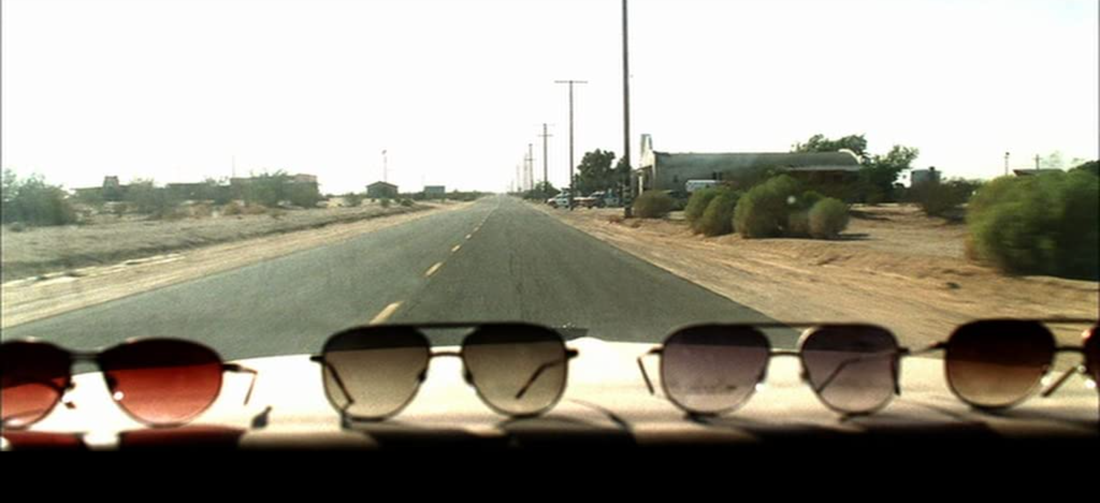
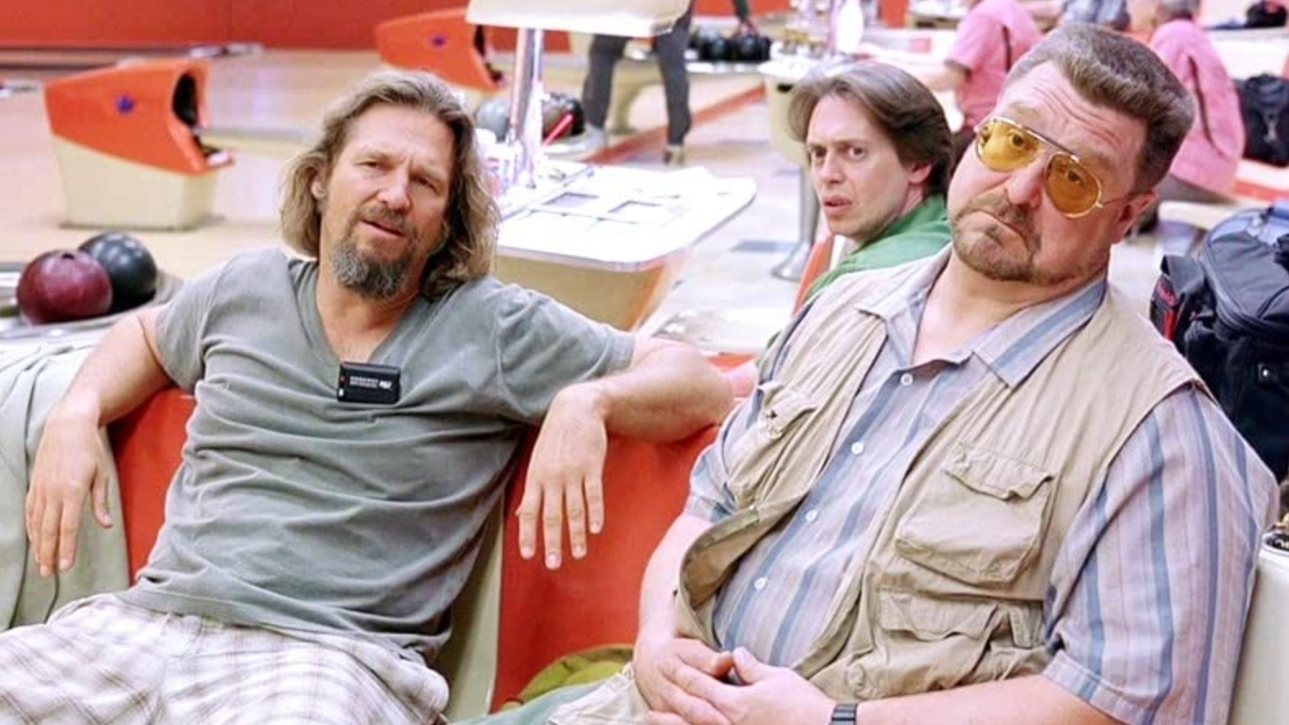
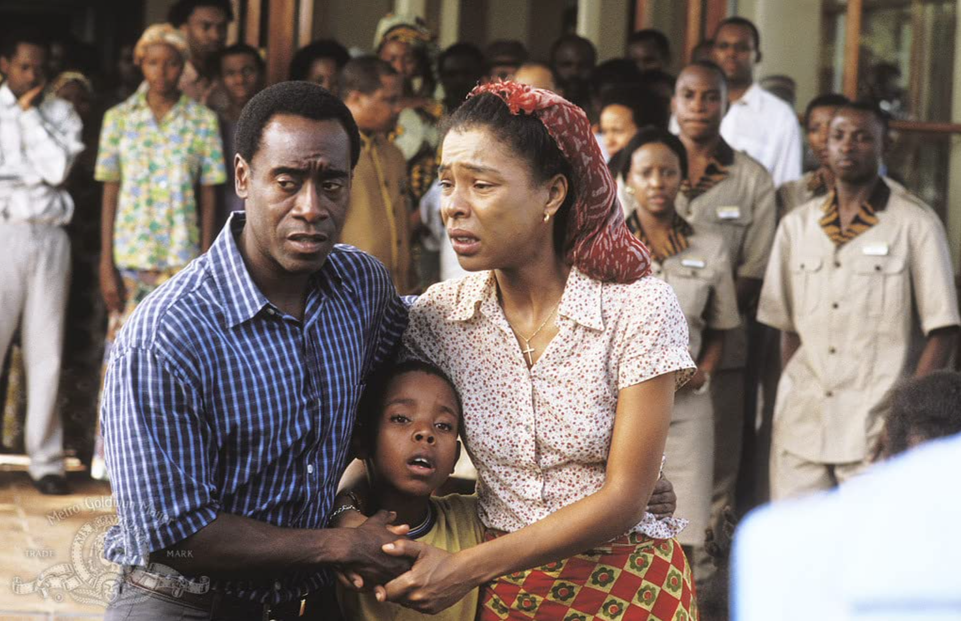
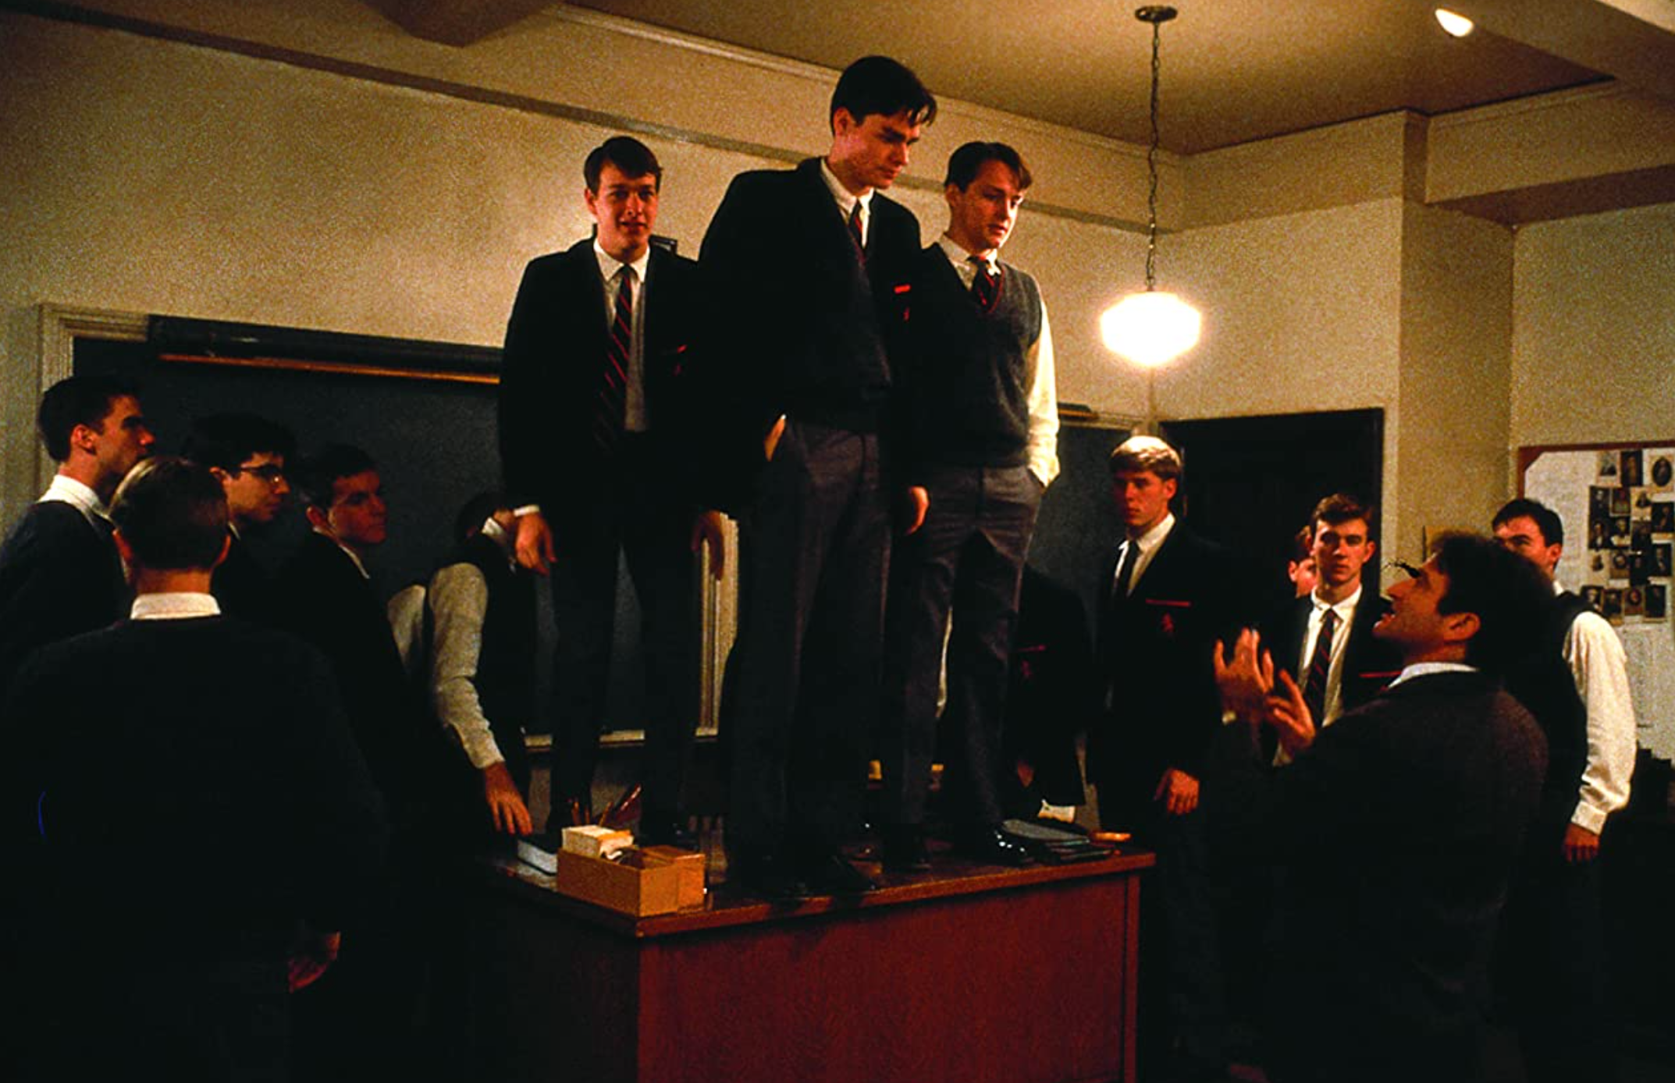
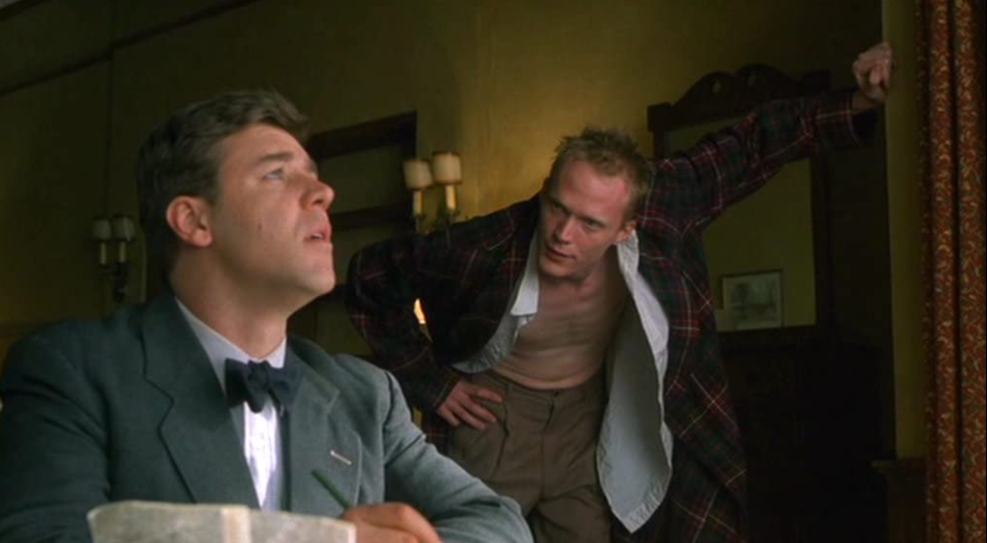
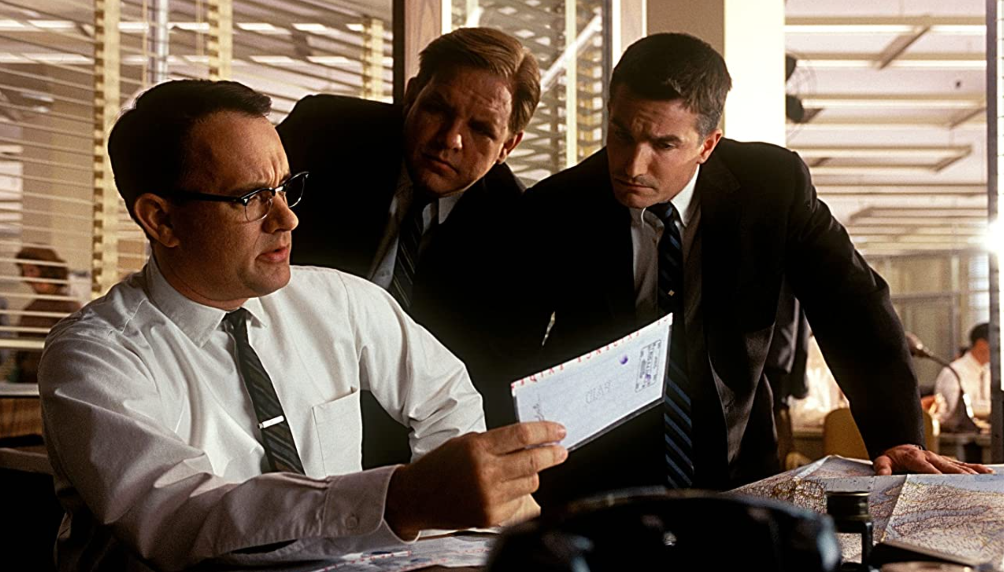
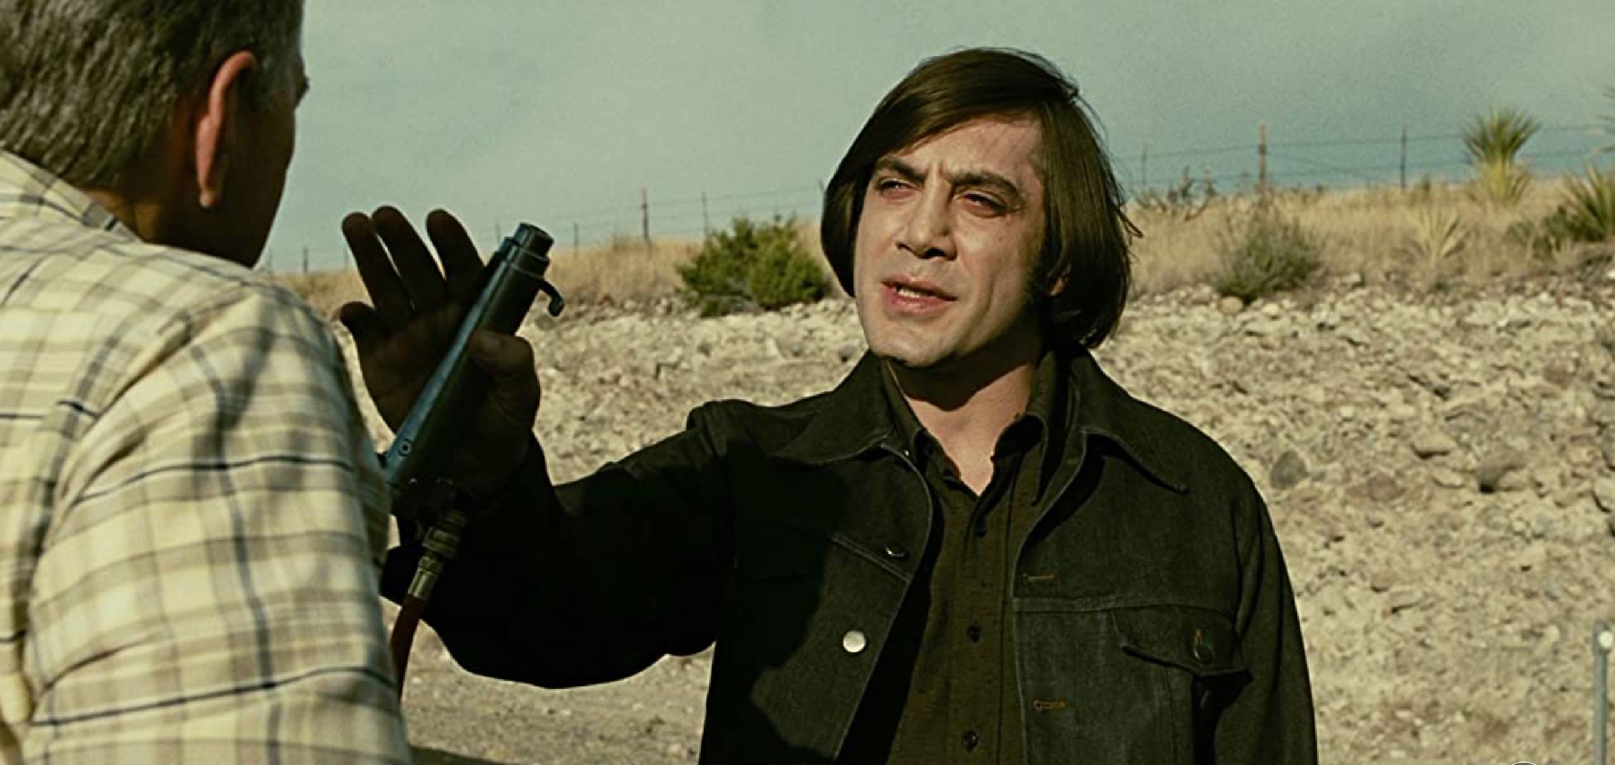
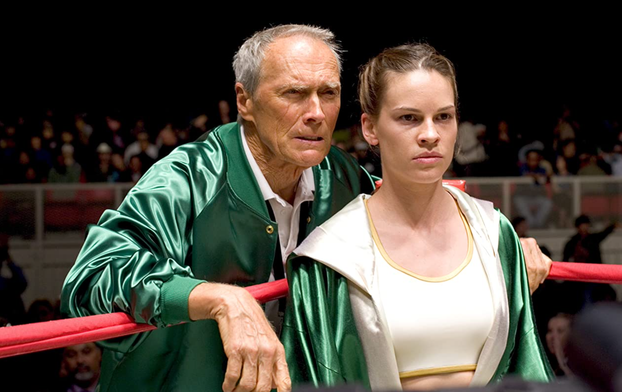
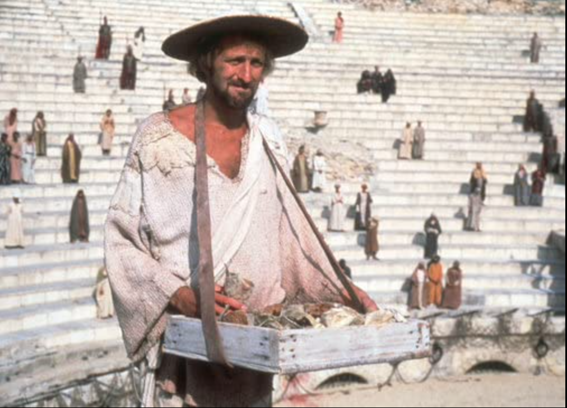
1.
2.
3.
4.
5.
6.
7.
8.
9.

Slide 45
PICTURE ROUND ANSWERS

Slide 46
PICTURE ROUND ANSWERS
1.
Kill Bill Vol. 1

Slide 47
PICTURE ROUND ANSWERS
2.
The Big Lebowski

Slide 48
PICTURE ROUND ANSWERS
3.
Hotel Rwanda

Slide 49
PICTURE ROUND ANSWERS
4.
Dead Poet's Society

Slide 50
PICTURE ROUND ANSWERS
5.
A Beautiful Mind

Slide 51
PICTURE ROUND ANSWERS
6.
Catch Me If You Can

Slide 52
PICTURE ROUND ANSWERS
7.
No Country for Old Men

Slide 53
PICTURE ROUND ANSWERS
8.
Million Dollar Baby

Slide 54
PICTURE ROUND ANSWERS
9.
Monty Python's Life of Brian

Slide 56
QUESTION 1.
In the Harry Potter novels, which of these was not a material used as a wand core?
A. Unicorn Tail
B. Thestral Horn
C. Dragon Heartstring
D. Phoenix Feather

Slide 57
QUESTION 2.
What is the second most commonly used letter in the english language?
A. A
B. E
C. I
D. T

Slide 58
QUESTION 3.
In transport, what do the initials MOT stand for
A. Motor Observation Test
B. Motor On-road Test
C. Motor Operating Test
D. Ministry of Transport

Slide 59
QUESTION 4.
Which is the worlds second lagest country by area?
A. China
B. USA
C. Russia
D. Canada

Slide 60
QUESTION 5.
Which anagram of "Cure" is also a pale colour?
A. Ecru
B. Crue
C. Ruce
D. Ceru

Slide 61
QUESTION 6.
According to the children's nursery rhyme, which child is loving and giving?
A. Tuesdays
B. Fridays
C. Saturdays
D. Thursdays

Slide 62
QUESTION 7.
Which type of transport would use a VTOL system?
A. Aircraft
B. Rail
C. Boat
D. Car

Slide 63
QUESTION 8.
In chess, which of these pieces is said to be more valuable?
A. Bishop
B. Knight
C. Rook
D. Pawn

Slide 64
QUESTION 9.
Who directed the film Trainspotting?
A. Guy Ritchie
B. Danny Boyle
C. Sam Mendes
D. Ridley Scott

Slide 65
QUESTION 10.
How many letters are in the spanish alphabet?
A. 25
B. 26
C. 27
D. 28

Slide 67
In the Harry Potter novels, which of these was not a material used as a wand core?
Q1.
A. Unicorn Tail
B. Thestral Horn
C. Dragon Heartstring
D. Phoenix Feather

Slide 68
What is the second most commonly used letter in the english language?
Q2.
A. A
B. E
C. I
D. T

Slide 69
In transport, what do the initials MOT stand for
Q3.
A. Motor Observation Test
B. Motor On-road Test
C. Motor Operating Test
D. Ministry of Transport

Slide 70
Which is the worlds second lagest country by area?
Q4.
A. China
B. USA
C. Russia
D. Canada

Slide 71
Which anagram of "Cure" is also a pale colour?
Q5.
A. Ecru
B. Crue
C. Ruce
D. Ceru

Slide 72
According to the children's nursery rhyme, which child is loving and giving?
Q6.
A. Tuesdays
B. Fridays
C. Saturdays
D. Thursdays

Slide 73
Which type of transport would use a VTOL system?
Q7.
A. Aircraft
B. Rail
C. Boat
D. Car

Slide 74
In chess, which of these pieces is said to be more valuable?
Q8.
A. Bishop
B. Knight
C. Rook
D. Pawn

Slide 75
Who directed the film Trainspotting?
Q9.
A. Guy Ritchie
B. Danny Boyle
C. Sam Mendes
D. Ridley Scott

Slide 76
How many letters are in the spanish alphabet?
Q10.
A. 25
B. 26
C. 27
D. 28

Slide 78

Track 1

Slide 79
Track 2

Slide 80
Track 3

Slide 81
Track 4

Slide 82
Track 5

Slide 83
Track 6

Slide 84
Track 7

Slide 85
Track 8

Slide 86
Track 9

Slide 87
Track 10

Slide 89
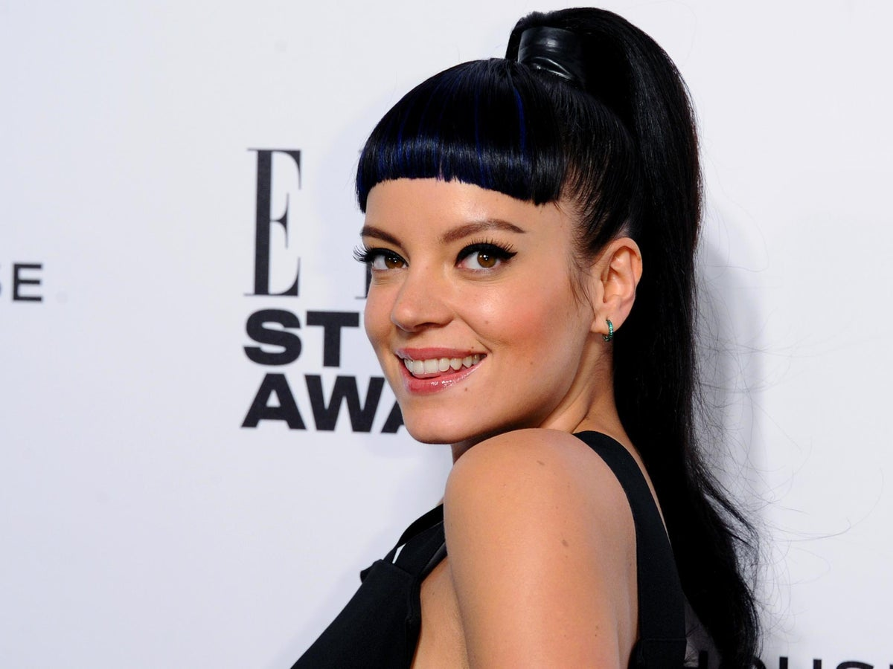

Track 1
Not Fair, Lily Allen

Slide 90
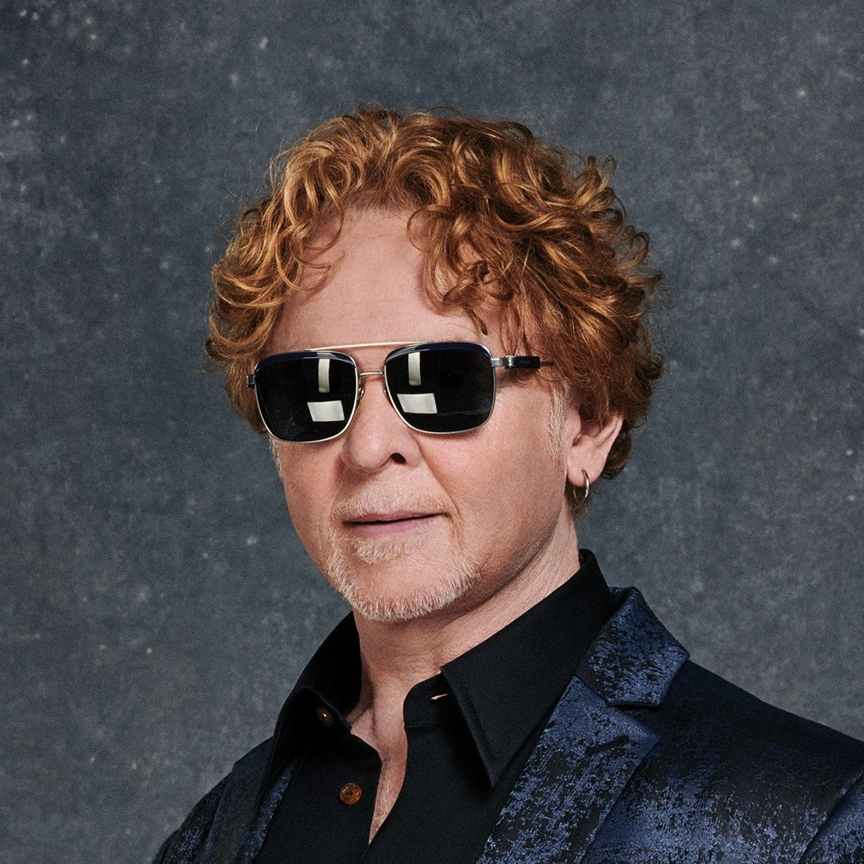
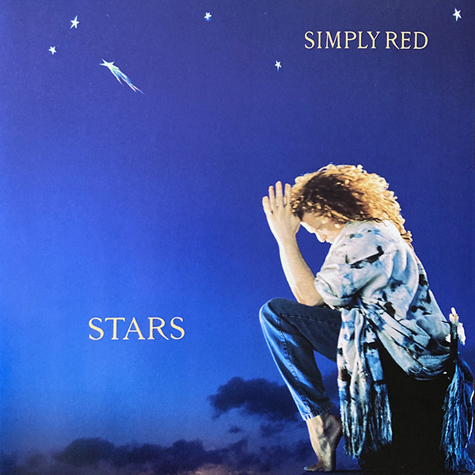
Track 2
Stars, Simply Red

Slide 91
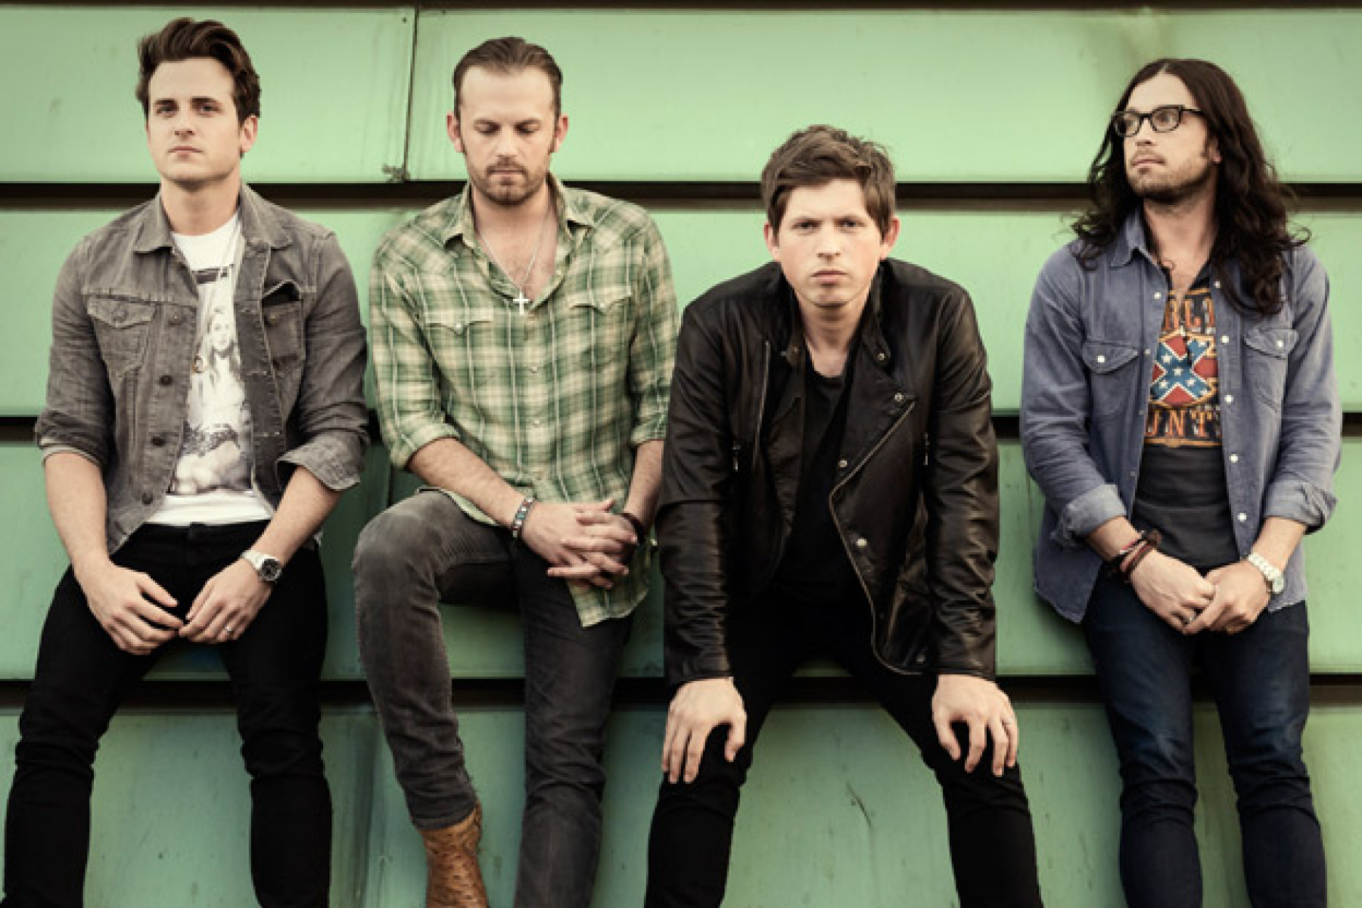
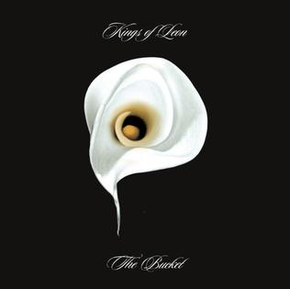
Track 3
The Bucket, Kings of Leon

Slide 92
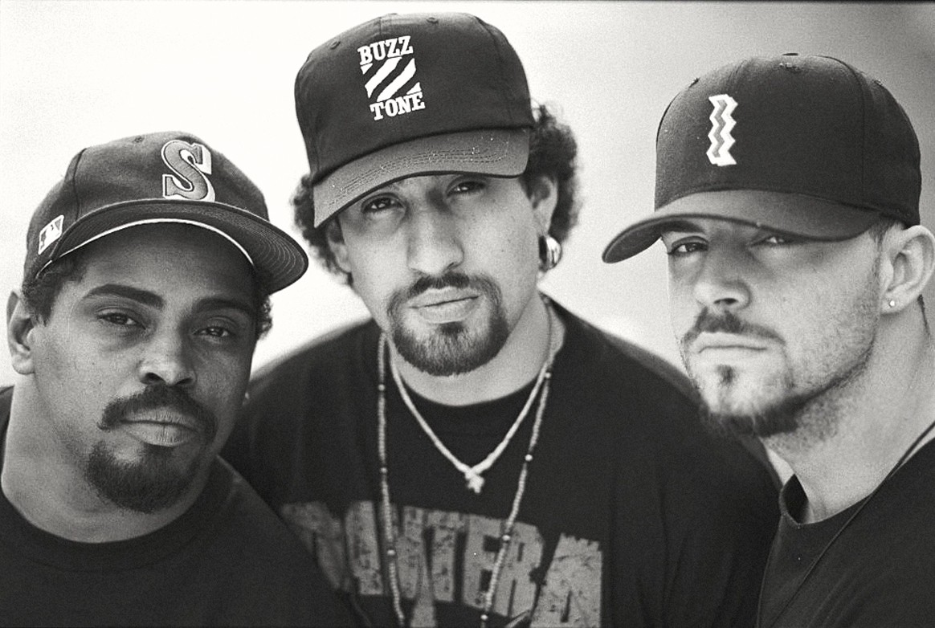
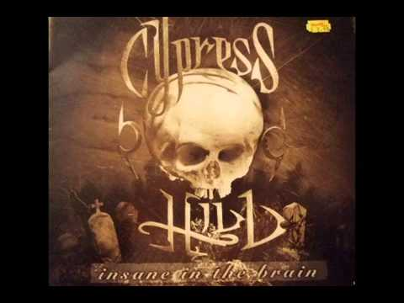
Track 4
Insane in the Membrane, Cypress Hill

Slide 93
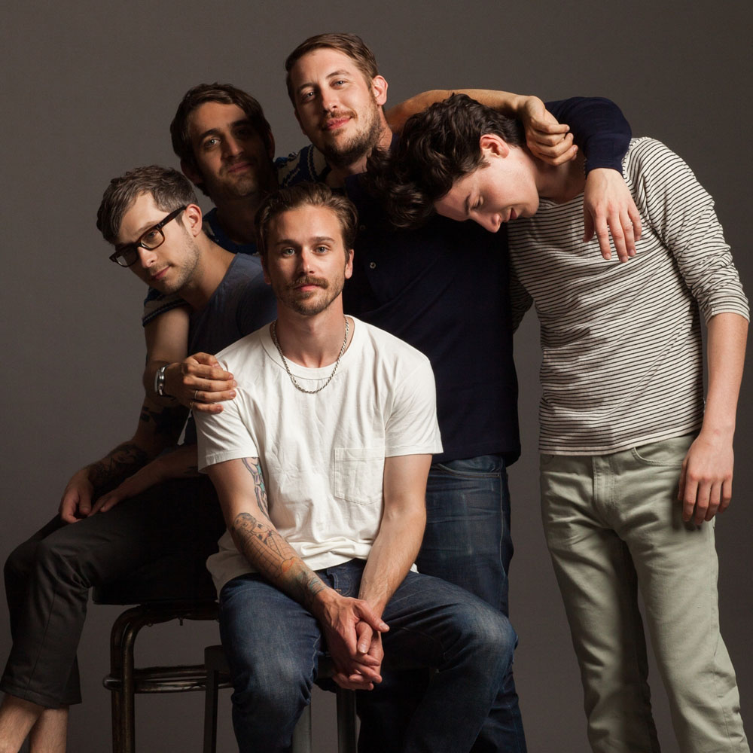

Track 5
Feel It Still, Portugal The Man

Slide 94
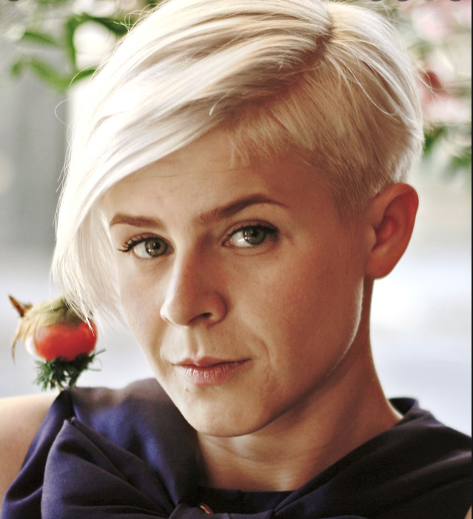
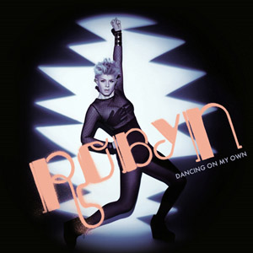
Track 6
Dancing On My Own, Robyn

Slide 95
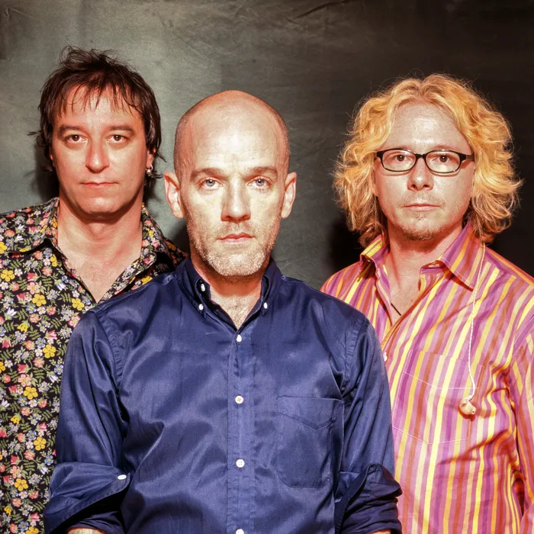
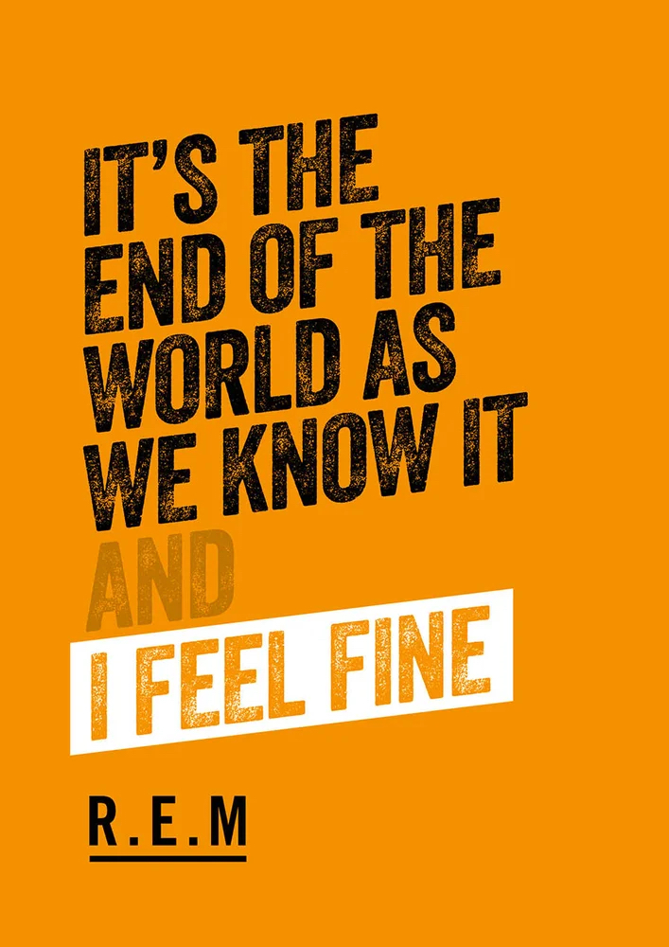
Track 7
It's the End of the World As We Know It, R.E.M.

Slide 96
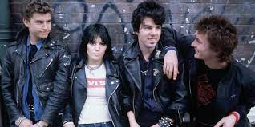
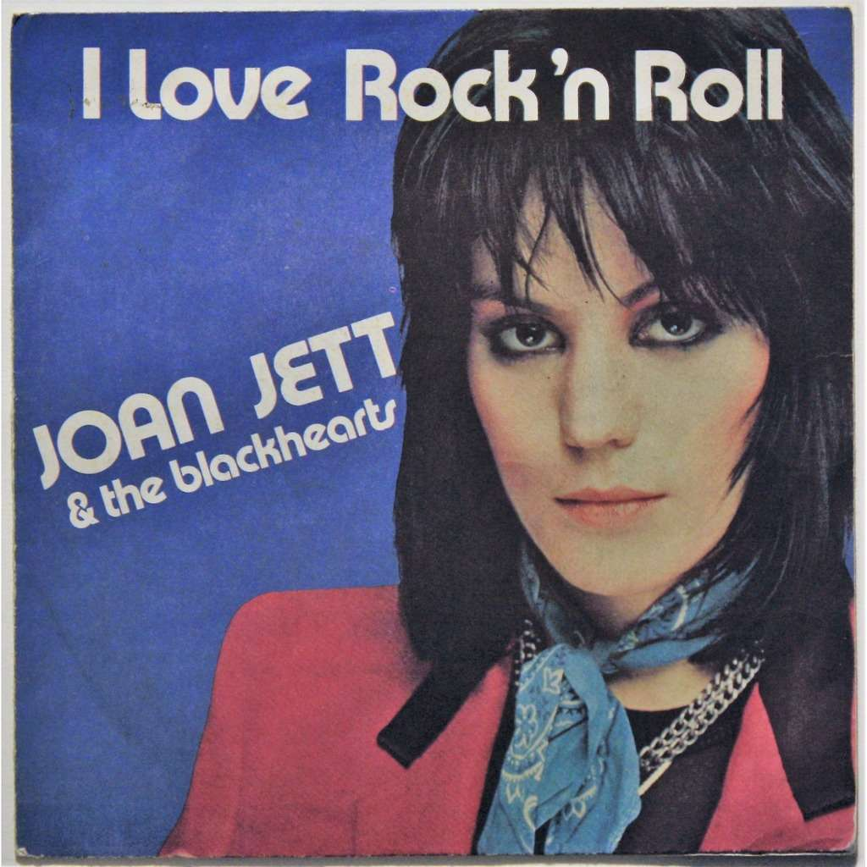
Track 8
I Love Rock 'N Roll, Joan Jett and the Blackhearts

Slide 97
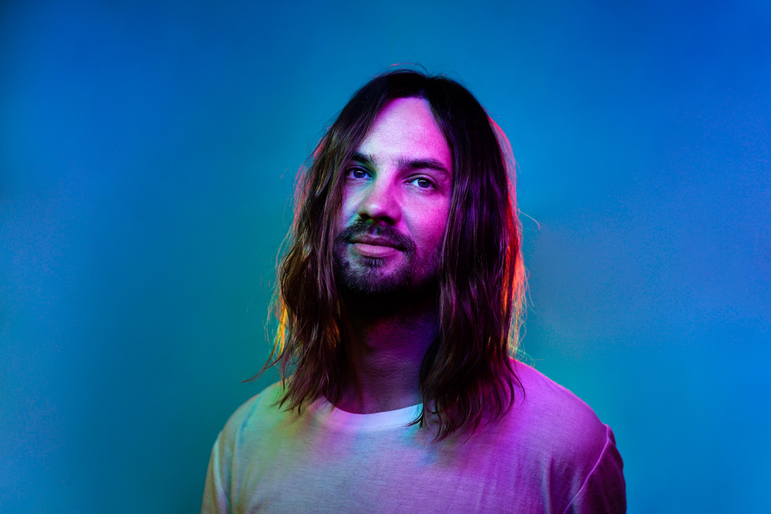
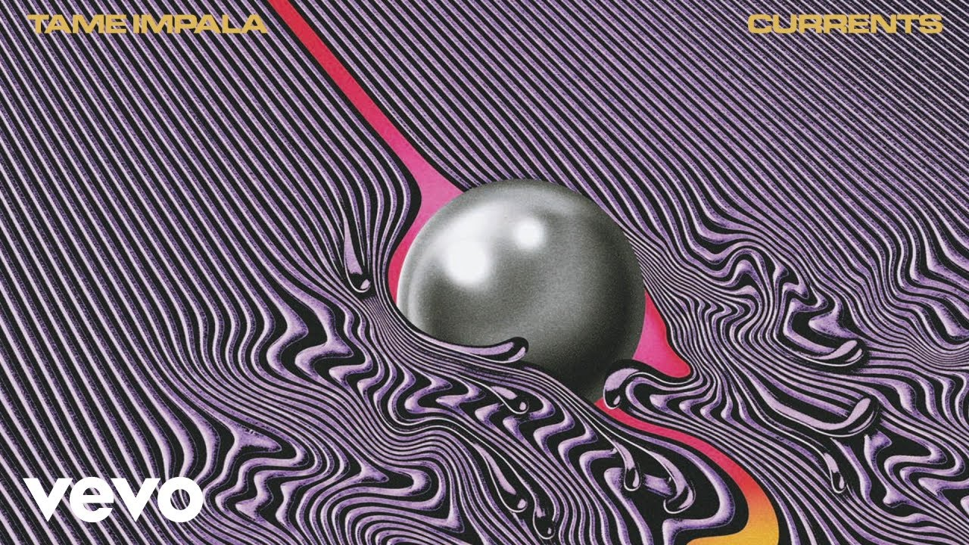
Track 9
Less I Know The Better, Tame Impala

Slide 98
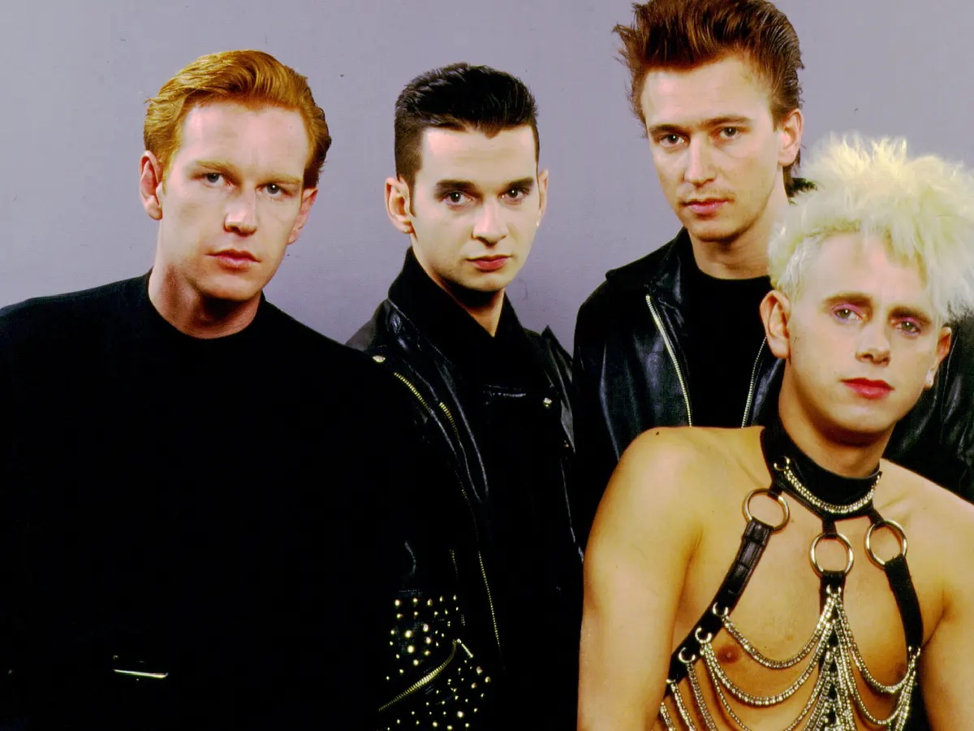
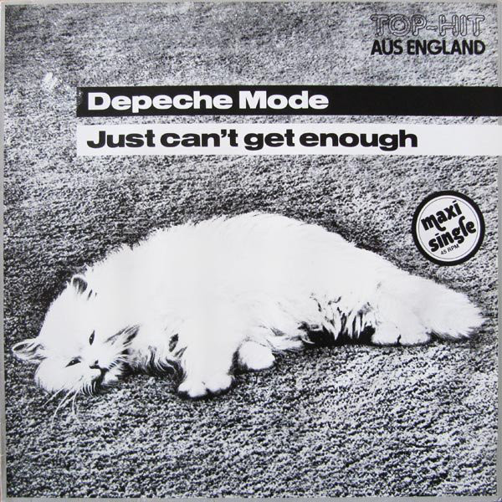
Track 10
Just Can't Get Enough, Depeche Mode

